Slide 1
Biblical Journey of Creation
Genesis 1
¹ In the beginning God created the heavens and the earth.
² Now the earth was formless and empty, darkness was over the surface of the deep, and the Spirit of God was hovering over the waters. ...
and then God spoke and created all things

Slide 2
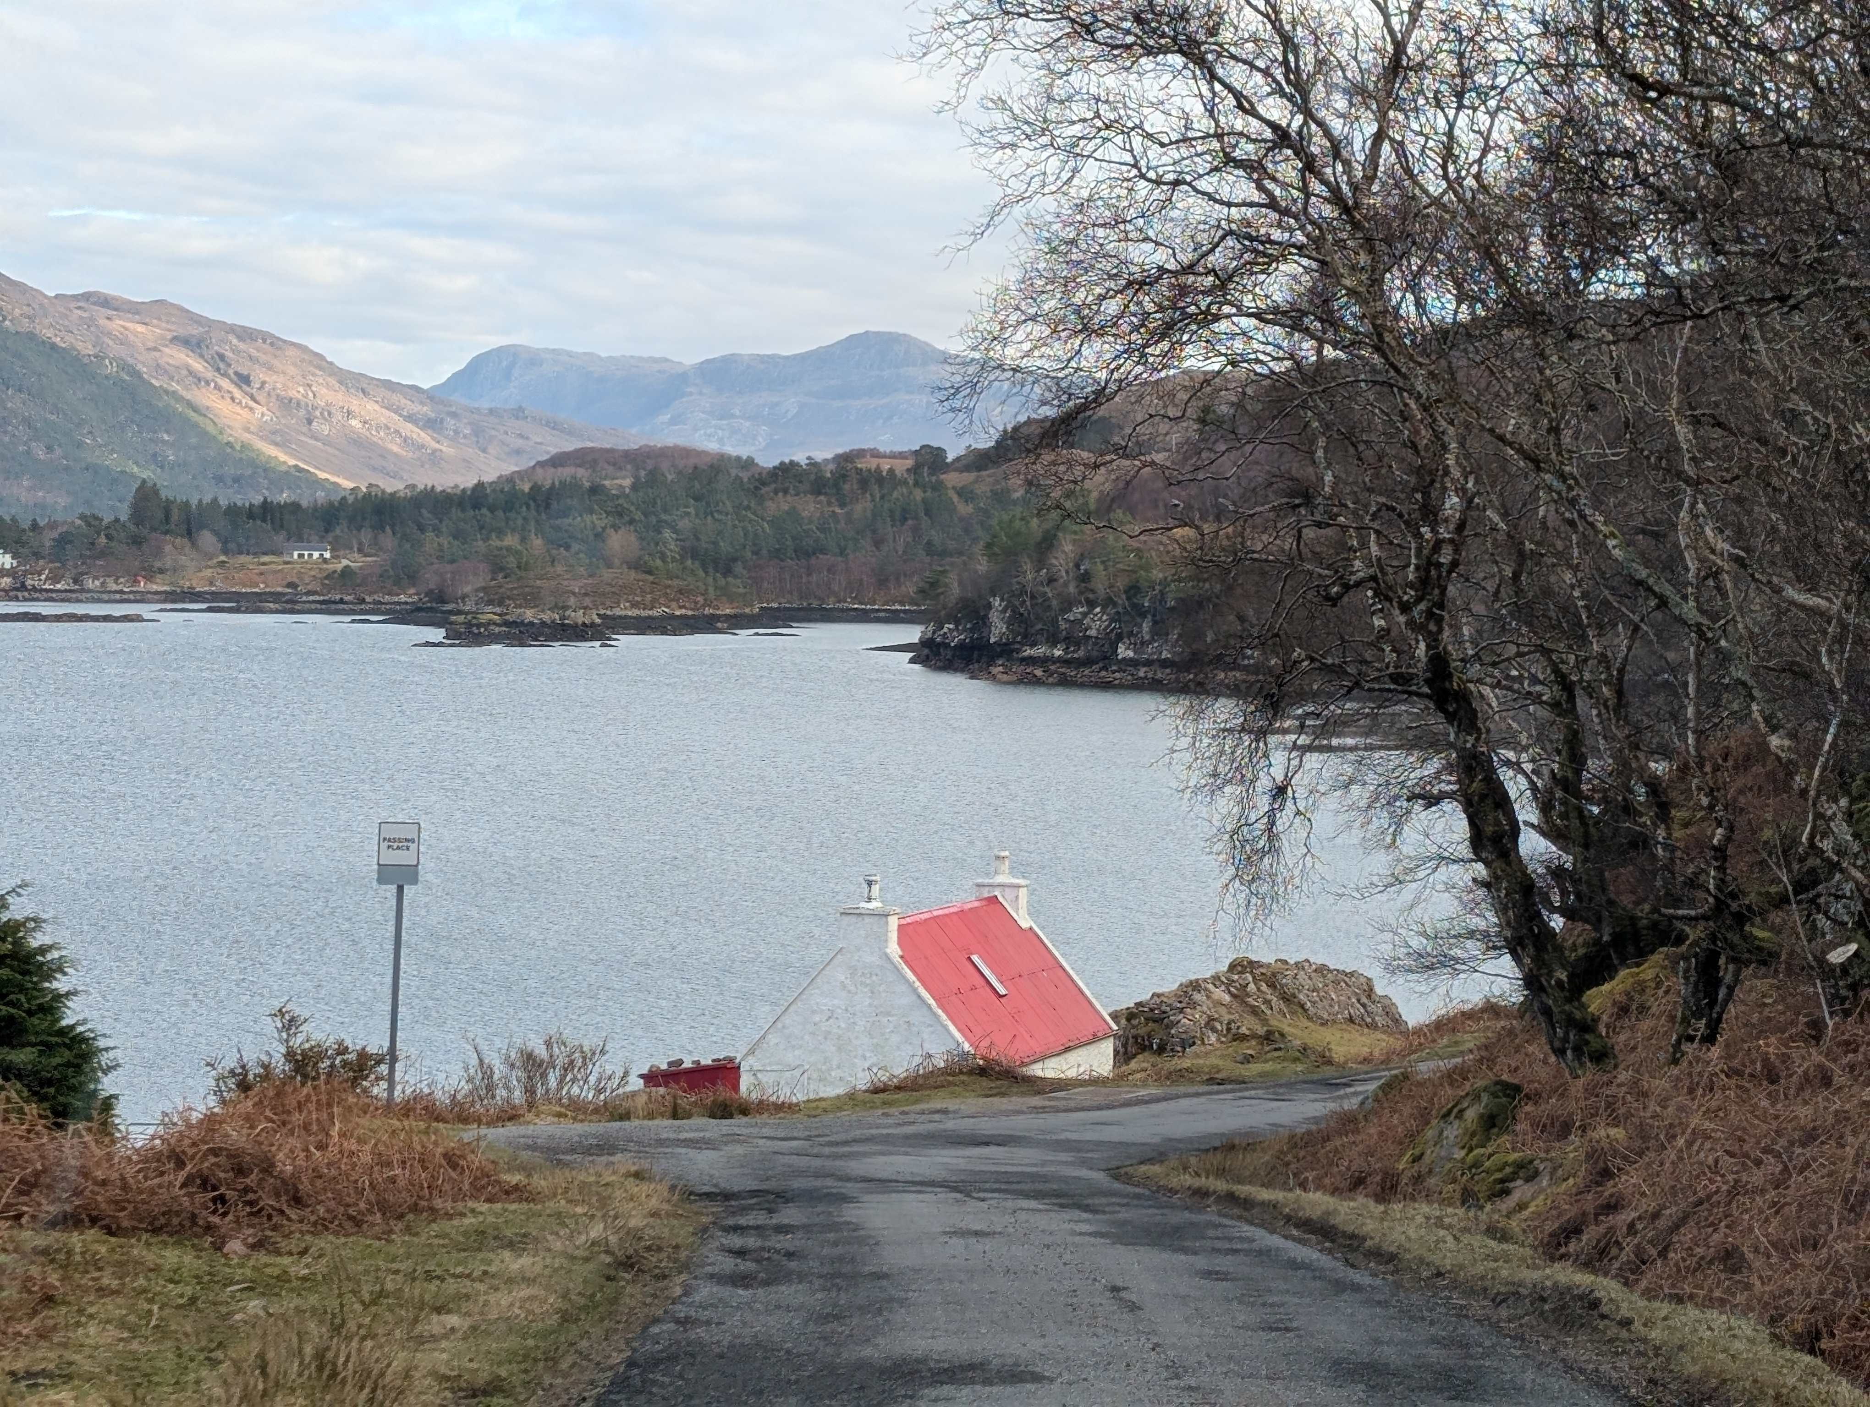
³¹ God saw all that he had made, and it was very good. And there was evening, and there was morning--the sixth day.

Slide 3
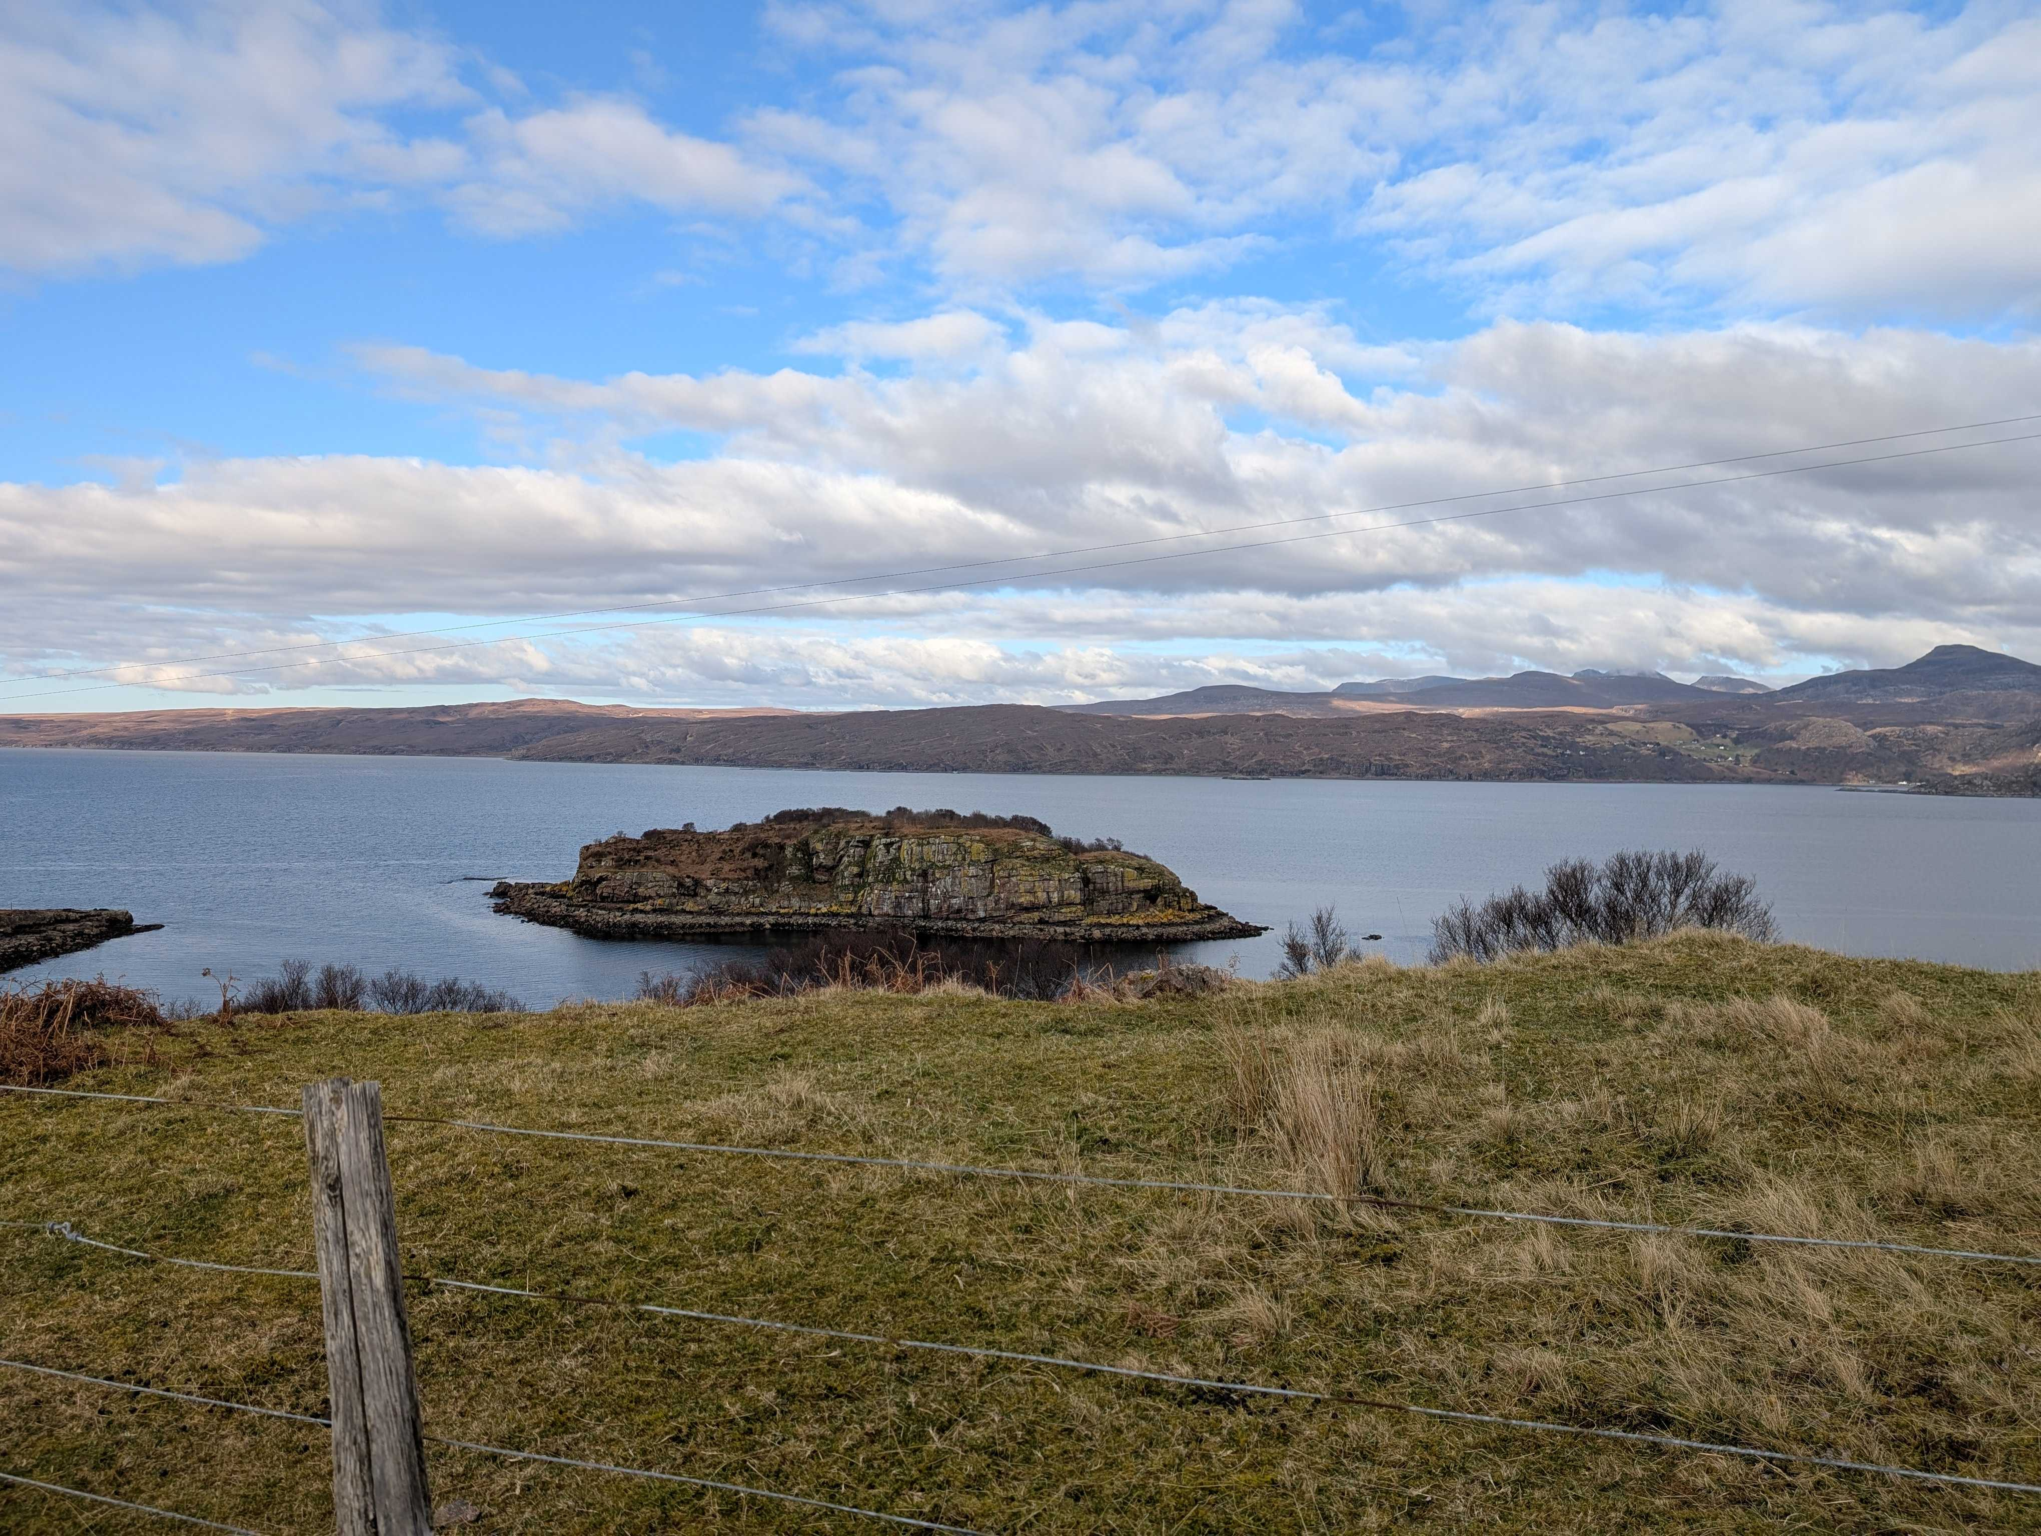
Isaiah acknowledges God
[He is] the Creator of the heavens, who stretches them out, who spreads out the earth with all that springs from it, who gives breath to its people, and life to those who walk on it.
(42:5)

Slide 4
God’s presence is everwhere
In His hand are the deep places of the earth; The heights of the hills are His also. The sea is His, for He made it; And His hands formed the dry land.
(Psalm 95:4-5)

Slide 5
Creation reveals God to us
For ever since the world was created, people have seen the earth and sky. Through everything God made, they can clearly see his invisible qualities—his eternal power and divine nature. So they have no excuse for not knowing God. (Romans 1:20)

Slide 6
Creation can teach us, if we would listen….
“But ask the beasts, and they will teach you; the birds of the heavens, and they will tell you; or the bushes of the earth, and they will teach you; and the fish of the sea will declare to you.
Who among all these does not know that the hand of the Lord has done this? In his hand is the life of every living thing and the breath of all mankind.
(Job 12:7-10)

Slide 7
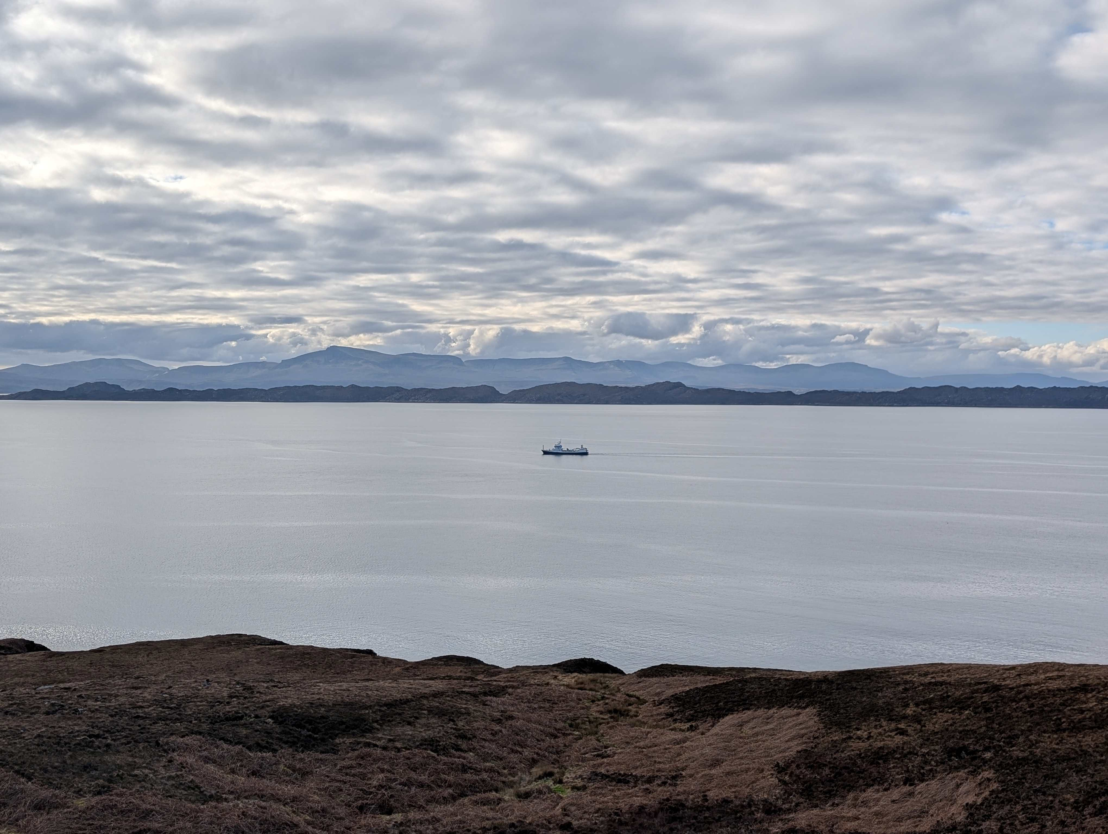
Creation is to be celebrated with joy
(Psalm 96)
Let heaven celebrate! Let the earth rejoice! Let the sea and everything in it roar! Let the countryside and everything in it celebrate! Then all the trees of the forest too will shout out joyfully

Slide 8
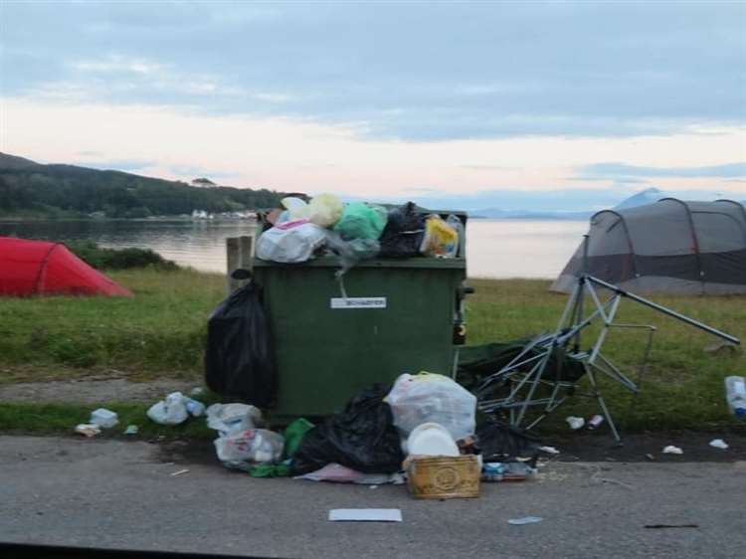
But sometimes we mess it up
We know that the whole creation has been groaning as in the pains of childbirth right up to the present time.
(Romans 8:22)

Slide 9
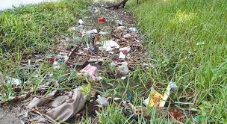
The earth dries up and withers the world languishes and withers; the heavens languish together with the earth.
The earth lies polluted under its inhabitants; for they have transgressed laws, violated the statutes, broken the everlasting covenant. Therefore a curse devours the earth, and its inhabitants suffer for their guilt;
therefore the inhabitants of the earth dwindled, and few people are left.
(Isaiah 24:4-6)

Slide 10
The Son of God came to re-create
John 1:1-5
¹ In the beginning was the Word, and the Word was with God, and the Word was God. ² He was with God in the beginning. ³ Through him all things were made; without him nothing was made that has been made. ⁴ In him was life, and that life was the light of all mankind. ⁵ The light shines in the darkness, and the darkness has not overcome it.

Slide 11
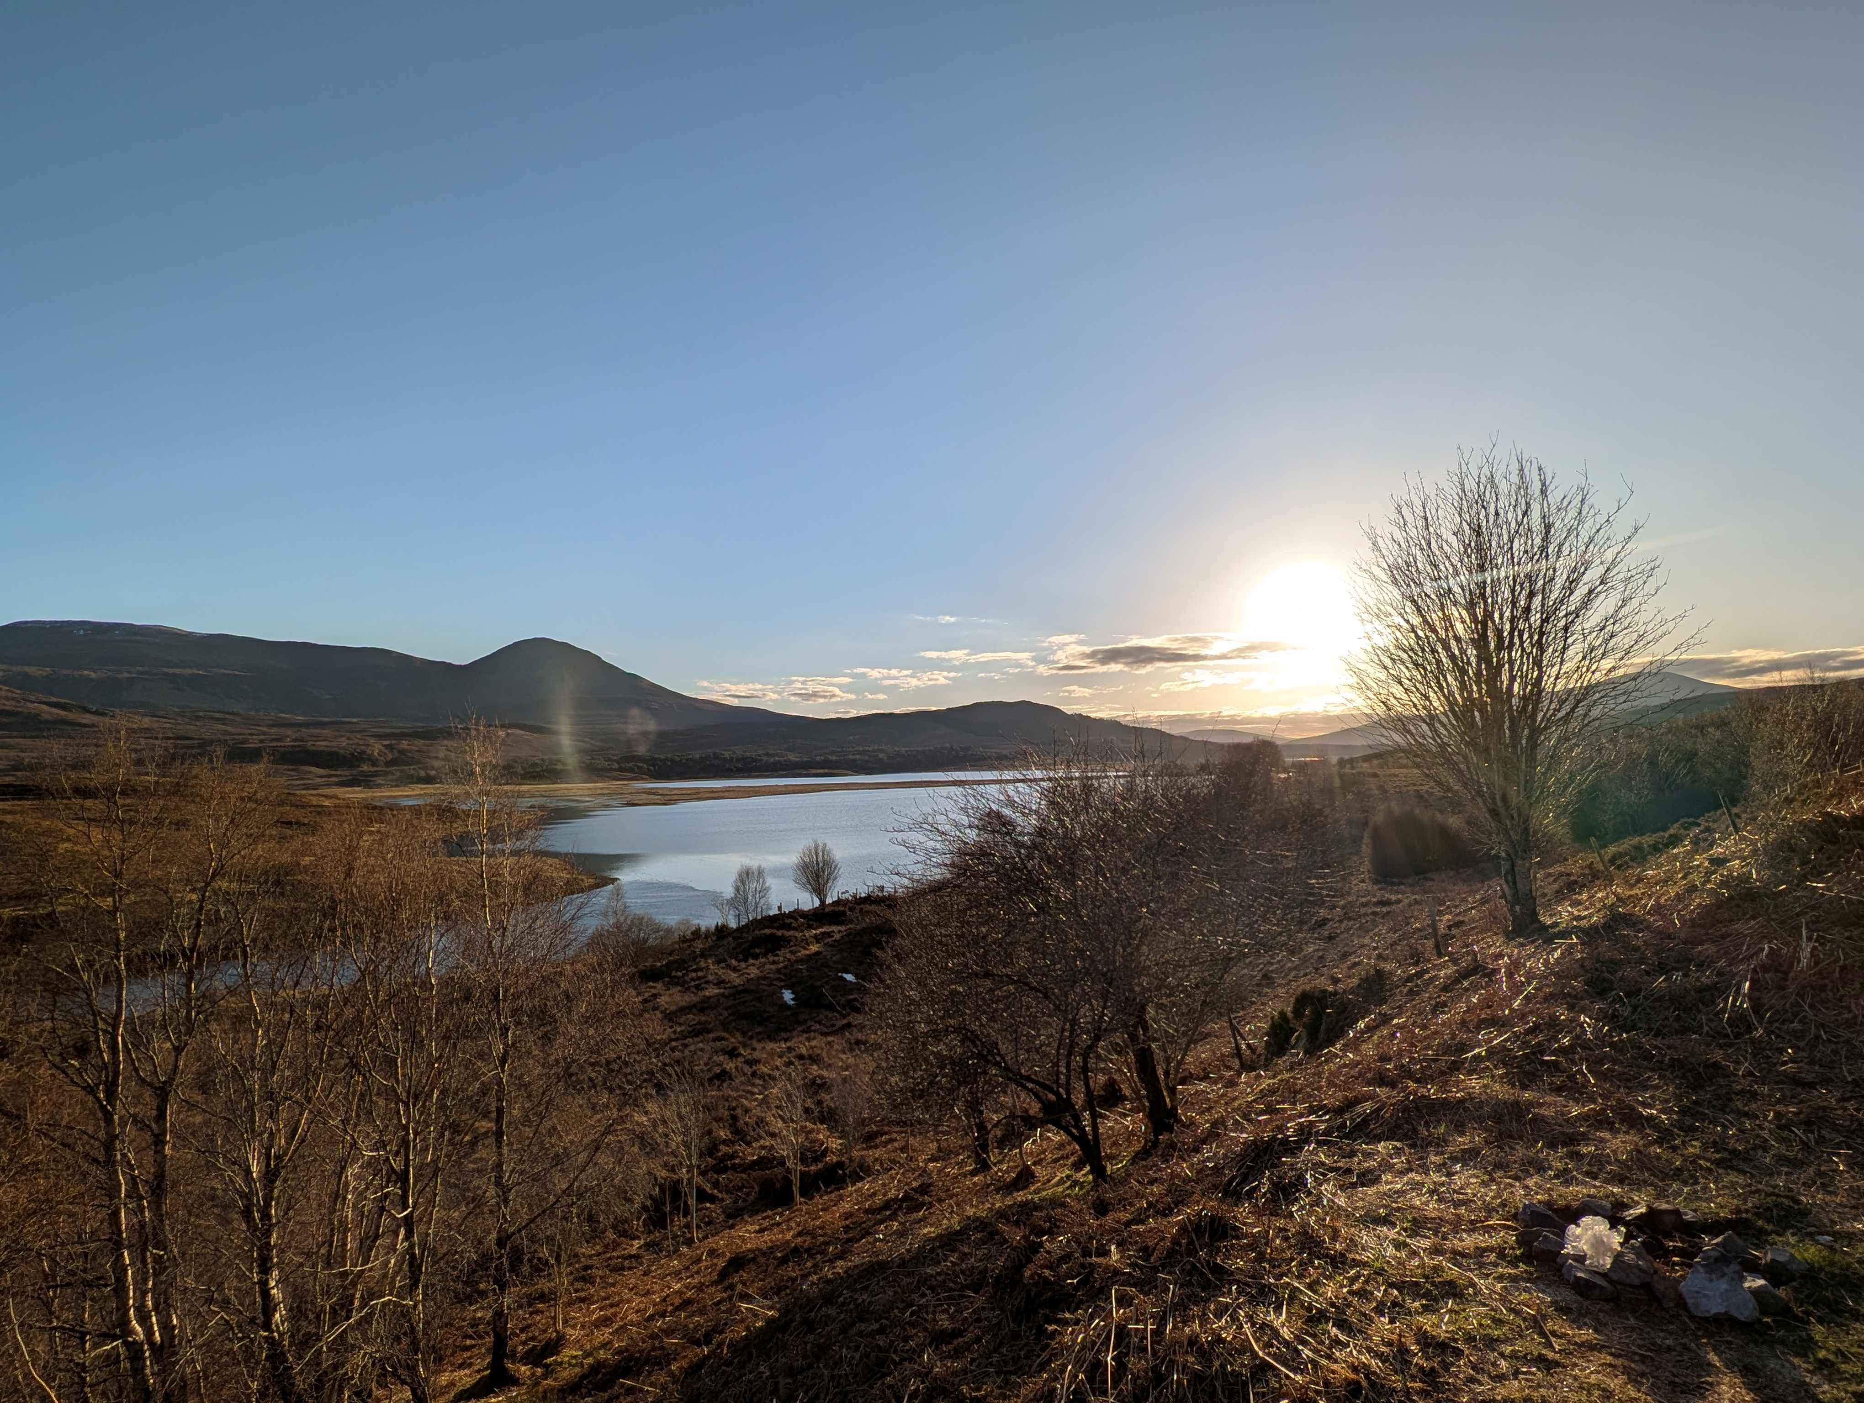
Our place in God’s work of re-creation
But seek first the kingdom of God and his righteousness, and all these things will be added to you.
Matthew 6:33

Slide 12
Our place in God’s work of re-creation
For the kingdom of God is not a matter of eating and drinking but of righteousness and peace and joy in the Holy Spirit.
Romans 14:7

Slide 13
And Jesus came and said to them, “All authority in heaven and on earth has been given to me. Go therefore and make disciples of all nations, baptizing them in the name of the Father and of the Son and of the Holy Spirit, teaching them to observe all that I have commanded you. And behold, I am
with you always, to the end of the age.”
Matthew 28:18-20

Slide 14
Looking forward to God’s New Creation
¹ Then I saw "a new heaven and a new earth," for the first heaven and the first earth had passed away, and there was no longer any sea. ² I saw the Holy City, the new Jerusalem, coming down out of heaven from God, prepared as a bride beautifully dressed for her husband. ³ And I heard a loud voice from the throne saying, "Look! God's dwelling place is now among the people, and he will dwell with them. They will be his people, and God himself will be with them and be their God.

Slide 15
⁴ 'He will wipe every tear from their eyes. There will be no more death' or mourning or crying or pain, for the old order of things has passed away." ⁵ He who was seated on the throne said, "I am making everything new!" Then he said, "Write this down, for these words are trustworthy and true.“
(Revelation 21:1-3)

Slide 16
Lord’s Prayer
Our Father, who art in heaven, hallowed be thy Name,
thy kingdom come, thy will be done,
on earth as it is in heaven.
Give us this day our daily bread.
And forgive us our debts, as we forgive our debtors.
And lead us not into temptation,
but deliver us from evil.
For thine is the kingdom,
and the power, and the glory,
for ever and ever. Amen.

Slide 17
God in such love for us lent us this planet, gave it a purpose in time and in space: small as a spark from the fire of creation, cradle of life and the home of our race.
Thanks be to God for its bounty and beauty, life that sustains us in body and mind: plenty for all, if we learn how to share it, riches undreamed-of to fathom and find.
(Hymn 240 in CH4)

Slide 18
Long have our human wars ruined its harvest; long has earth bowed to the terror of force; long have we wasted what others have need of, poisoned the fountain of life at its source.
Earth is the Lord's: it is ours to enjoy it, Ours, as God's stewards, to farm and defend. From its pollution, misuse, and destruction, good Lord, deliver us, world without end!
(Hymn 240 in CH4)

